Slide 1
C++ Programming Today 2nd Edition By Barbara Johnston Chapter 6
Instructor: <Instructor Name>
Lecture Slides by Kelly Montoya and Rob Garner

Slide 2
Chapter 6
Array Fundamentals
Loops and Arrays
Array Declaration and Initialization
Array Out of Bounds
Vectors and Arrays
Arrays and Functions
Example using Arrays and Functions
Character Arrays
Character Array Initialization
The Null Character
Character Array
Data Structures
Filling Arrays from Data Files
The ifstream and ofstream Classes
Using Char Delimiters with GetLine
Parsing Strings
Converting Strings to Numbers
Multi-dimensional Arrays
Two-Dimensional Array Initialization
Nested for Loops and Two-Dimensional Arrays
Multi-dimensional Arrays and Functions
Common Errors With Arrays

Slide 3
Multi-dimensional Arrays
Explain the purpose of multi-dimensional arrays

Slide 4


Multi-dimensional Arrays
Multi-dimensional arrays represent a table with rows and columns.
The declaration for a two-dimensional array is:
dataType arrayName [num rows][numcol];
Examples:
This grid has 3 rows and 4 columns
This image has 640 rows and 480 columns

Slide 5

A three-dimensional array is declared with rows, columns, and height (or layers):
dataType arrayName [num rows][num col][num layers];
An example of a 3D array containing geographic information over time:

Slide 6
One-, two-, and three-dimensional array declarations and the
manner in which the elements of the array can be visualized.

Slide 7
Declare an array of integers with two dimensions called lotNumber. Dimension one has 15 elements. Dimension two has 12 elements.

Slide 8
Declare an array of floats with four dimensions called tesseract. All dimensions have three elements.

Slide 9
Two-Dimensional Array Initialization
Explain how to initialize two-dimensional arrays

Slide 10

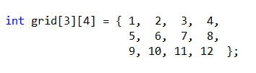
Two-Dimensional Array Initialization
Two-dimensional arrays can be initialized when declared, and C++ fills the rows of the array first.
Initializing Two-Dimensional Arrays:
Another way to make it easier to visualize is:

Slide 11
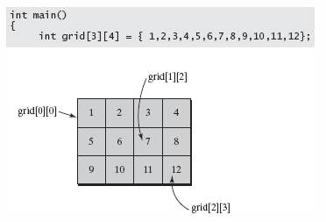
Initializing two-dimensional arrays.

Slide 12
Declare a two dimensional array of chars called letters with two elements in each dimension. Initialize it to a, b, c, d.

Slide 13
Nested for Loops and Two-Dimensional Arrays
Explain how to use nested for loops to traverse two dimensional arrays

Slide 14
Nested for Loops and Two-Dimensional Arrays
Two-dimensional arrays require two indexes.
Name the integer index variables appropriately so that the code is easy to read.
Set up a two-dimensional array of float values called grid that is 100 rows by 50 columns.
Nested for loops will be used to access each array variable and to place zero in each element.

Slide 15
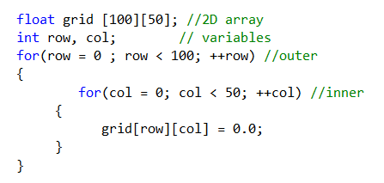
In the code below, this set of nested for loops will traverse the array, moving across each row.

Slide 16
Accessing Elements 100 x 50 two-dimensional array using nested loops.
Notes:
In Program 6-11 we use the random number generator to help us build a Bingo card.

Slide 17
Program 6-11
Sample Program

Slide 18
Multi-dimensional Arrays and Functions
Explain how to pass multi-dimensional arrays to functions.

Slide 19
Multi-dimensional Arrays and Functions
When passing an array (reference) to a function, two-, three-, and higher dimensional arrays require that the programmer specify all but the beginning array size in the prototype and function header line.
When you declare a multidimensional array, C++ multiples the dimensions together and reserves that many elements for the array.

Slide 20

For example, if you declared these two arrays:
C++ reserves 160 integers for both sets of data.
In order for a function to know how to interpret the data correctly, we need to give it enough information so that it knows the number of rows and columns.

Slide 21


For example, if a program has a two dimensional array, like this:
The function prototype and function header line need to know that the array reference is for a 2-D array, as well as how the data is organized.
The prototype is:

Slide 22
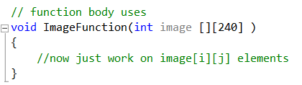
It is then business as usual inside the function.
Notes:
Program 6-12 produces a Bingo card with no duplicate values on the card. The program is designed to use two functions, FillCard and PrintCard.
Program 6-13 sets up an array for Snow White that will initialize the dwarfs’ names and then call a function to print the names to the screen.

Slide 23
Program 6-12
Sample program

Slide 24
Chapter 6
Array Fundamentals
Loops and Arrays
Array Declaration and Initialization
Array Out of Bounds
Vectors and Arrays
Arrays and Functions
Example using Arrays and Functions
Character Arrays
Character Array Initialization
The Null Character
Character Array
Data Structures
Filling Arrays from Data Files
The ifstream and ofstream Classes
Using Char Delimiters with GetLine
Parsing Strings
Converting Strings to Numbers
Multi-dimensional Arrays
Two-Dimensional Array Initialization
Nested for Loops and Two-Dimensional Arrays
Multi-dimensional Arrays and Functions
Common Errors With Arrays

